Slide 1
Decorator Pattern

Slide 2
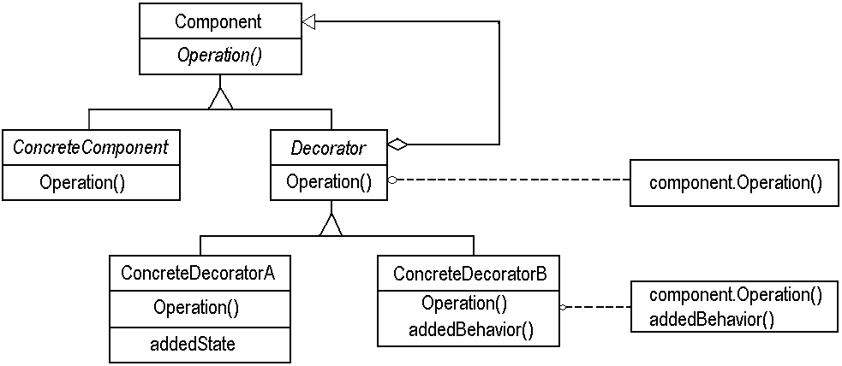
Decorator Pattern: Review
Interface for objects that can have responsibilities added to them dynamically
Core object to which additional responsibilities can be attached.

Slide 3
Decorator Example: Object Diagram
aBorderDecorator
component
aScrollDecorator
component
aTextView

Slide 4


Another Example
FileReader frdr = new FileReader(filename);
LineNumberReader lrdr = new LineNumberReader(frdr);
String line;
while ((line = lrdr.readLine()) != null) {
System.out.print(lrdr.getLineNumber() + ":\t" + line);
}

Slide 5
Another Decorator Example
We can decorate a FileInputStream with an ObjectInputStream :
  So you can read objects that implement Serializable Interface

Slide 6
Java streams
With > 60 stream decorators in Java, you can create a wide variety of input and output streams:
  This provides flexibility -- good
  It also adds complexity -- bad

Slide 7
Decorator: Pros
More flexible than static inheritance:
  Responsibilities can be added and removed at run-time
  Decorators also make it easy to add a property twice. For example, to give a TextView a double border, simply attach two BorderDecorators. Inheriting from a Border class twice is error.
Avoids inheriting from feature-laden classes.
  An application needn't pay for features it doesn't use.
  It's also easy to define new kinds of Decorators independently from the classes of objects they extend.

Slide 8

Decorator: Cons
Lots of little objects:
  The objects differ only in the way they are interconnected, not in their class or in the value of their variables.
  Although these are easy to customize by those who understand them, they can be hard to learn and debug.

Slide 9
Aggregation vs. inheritance
Both are ways to re-use functionality
Inheritance:
  Re-use functionality of parent class
  Statically decided
  Weakens encapsulation
Aggregation:
  Re-use functionality of objects at run-time
  Invoked through the base interface
  Dynamic: multiple types with same interface
  Black-box re-use

Slide 10
Aggregation vs. Inheritance cont…
Inheritance is a quick and easy way to design new components:
  These are variants of existing ones
However, indiscriminate use of inheritance creates bloated hierarchies
  Code is more difficult to maintain
  Unnecessary baggage for many classes
Aggregation drawback: it is harder to understand the behavior of a program by looking only at its source code…
  Semantics of interaction are decided at run-time

Slide 11
Decorator: Consequences:
  Responsibilities can be added/removed at run-time
  Avoids subclass explosion
  Recursive nesting allows attachment of multiple responsibilities
Implementation Issues:
  Use lightweight classes as Decorators
  Heavyweight classes make Strategy pattern more attractive

Slide 12
Decorator: Final Comments
The Decorator pattern gives you flexibility:
  You can change a decorator at runtime, as opposed to having responsibility bound statically and determined at compile time by subclassing.
Since a Decorator complies with the interface of the object that it contains:
  The Decorator is indistinguishable from the object that it contains and from any other concrete instances, including other decorated objects.
This is powerful and can be used to great advantage:
  You can recursively nest decorators without any other objects being able to tell the difference, allowing significant customization.

Slide 13
Proxy Pattern

Slide 14
Proxy (Surrogate) Pattern
Problem: How should a client invoke the services of a server when access to the server should be managed in some way?
Solution: A proxy object should be created at the client side.
Explanation: The proxy can help to
  Authenticate
  Hide details of network operations.
    Determine server address,
    Communicate with the server, obtain server response and seamlessly pass that to the client, etc.
c
c
S
c
c
c

Slide 15
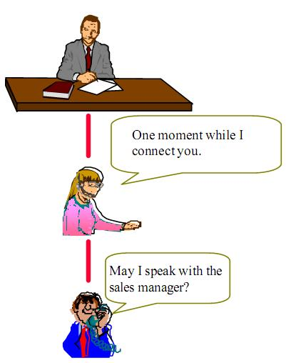
Proxy: Non-software example 1
To control access to an object:
  Provide a surrogate for the object
May I know who is speaking?
May I speak to the manager?

Slide 16
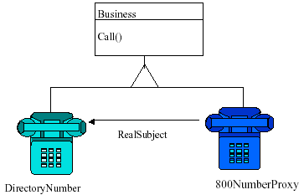
Proxy: Non-software example 2
    Toll-free numbers
Client dials the “800” std code just like any other number
Proxy records billing information and connects to the nearest call center.

Slide 17
Non-software Example 3: Payment By Cheque
Problem:
A person has cash in his bank account but does not carry cash with him as it is cumbersome. Wants to make purchase…
Solution:
Proxy.

Slide 18
Payment by Cheque Example Contd...
The cheque acts as a proxy for the fund in the account.
The fund is the real subject.
  The client asks for payment through a Cheque.
The proxy (cheque) behaves:
  As if it was actual fund.

Slide 19
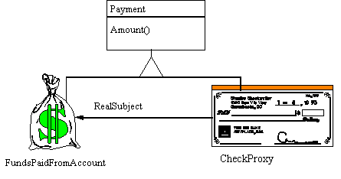
Proxy Design Pattern

Slide 20
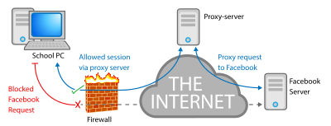
Digression: Network Proxy Server
What is the role of a network proxy server?
  To keep machines behind it anonymous, mainly for security.
  To speed up access to resources using caching.
  To prevent downloading the same content multiple times and save bandwidth.
  To log / audit usage, e.g. to provide company employee Internet usage reporting.
  Firewall and filtering: Scan for malware

Slide 21
Encryption / SSL acceleration: Secure Sockets Layer (SSL) encryption is often not done by the web browser itself, but by proxy that is equipped with SSL acceleration hardware.
Load balancing: can distribute the load to several web servers, each web server serving its own application area.
Compression: proxy server can optimize and compress the content to speed up the load time.
Spoon feeding: reduces resource usage caused by slow clients by caching the content the web server sent and slowly "spoon feeding" it to the client.

Slide 22

Proxy: Some Insights
Use Proxy pattern whenever the services provided by a supplier need to be managed in some way without disturbing the supplier.
Example: You require some additional conditions to be satisfied before the actual object is accessed:
    Consider loading an image from disk only when it is actually needed.

Slide 23
Proxy Pattern
The proxy object has the same interface as the target object:
  Proxy stores a reference to the target object…
  Forwards (delegates) requests to it.
Often more sophistication needed than just a simple method call to an object:
  That is, we want to wrap code around the references to an object
<<interface>>
Subject
Client
request()
...
RealSubject
delegate
Proxy
request()
request()
...
...

Slide 24
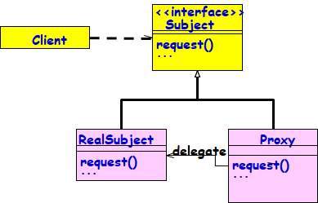
Proxy: A Wrapper Pattern
A Structural Pattern:
  Provides surrogate for some object,
  Controls access to real target object.
Real target may not always be instantiated immediately:
  Due to performance, location, or access restrictions.

Slide 25
Proxy Solution
Create a Proxy object that implements the same interface as the real object
The Proxy object contains a reference to the real object
Clients are given a reference to the Proxy:
  Not the real object
All clients invoke operations on the Proxy:
  Allows the Proxy to perform additional processing
<<interface>>
Subject
Client
request()
...
RealSubject
delegate
Proxy
request()
request()
...
...
Client
Proxy
Real Object

Slide 26
Proxy Structure
Class Diagram
<<abstract>>
Subject
Client
request()
{
...
request()
...
realSubject.request()
...
}
RealSubject
Proxy
delegate
request()
request()
...
...

Slide 27
Proxy: Class Structure
Three Classes: Subject, RealSubject, and Proxy.
Interface Subject:
  Implemented both by RealSubject, and Proxy.
Proxy:
  Delegates any calls to RealSubject.
Client:
  Always uses Proxy.

Slide 28
Proxy Usage 1: Helps Save Expensive Steps
What is expensive?
  Heavy weight object Creation
  Object Initialization
Helps defer object creation and initialization to the time we actually need the object.
Proxy pattern:
  Helps reduce the cost of accessing objects
  The proxy object acts as a stand-in for the real object
  The proxy creates the real object only if the user asks for it…

Slide 29
Example
Subject
<<interface>>
f();
p();
g();
Proxy
f();
p();
g();
RealSubject
f();
p();
g();
delegate

Slide 30
Proxy
Code
Client Code:
Proxy p = new Proxy();
public void test() { p.f(); p.g(); p.h(); }
interface Subject { void f(); void g(); void h();}
class Proxy implements Subject {
private Subject implementation;
public Proxy() { implementation = new RealSubject(); }
public void f() {implementation.f();}
public void g() {implementation.g();}
public void h() {implementation.h();}
}
class RealSubject implements Subject {
public void f() {System.out.println("Implementation.f()");}
public void g() {System.out.println("Implementation.g()");}
public void h() {System.out.println("Implementation.h()");}
}

Slide 31
Proxy Design Pattern
Client
<<abstract>>
Subject
expensiveMethod()
anotherMethod()
Instantiate with
Proxy object
Proxy
expensiveMethod()
anotherMethod()
RealSubject
expensiveMethod()
realActiveObject
. . . // Check if it is really needed:
if ( realActiveObject == null ) // never referenced
{ realActiveObject = getRealActiveObject();
realActiveObject.expensiveMethod();
}
else // try to avoid calling the real expensiveMethod()

Slide 32
Sequence Diagram for Proxy
:Client
:Proxy
:RealSubject
expensiveMethod()
[if needed]
realExpensiveMethod()
  Proxy forwards requests to RealSubject when appropriate.

Slide 33
Kinds of proxies
Virtual proxy:
  Delays the creation or loading of large or computationally expensive objects (lazy construction)
  Proxy is a standin --- postpones accessing the real subject.
Remote proxy:
  Use a local representative for a remote object (different address space)
  Hides the fact that an object is not local
  Encodes and sends the request to the real subject in a different address space.

Slide 34
Kinds of Proxies cont…
Synchronization Proxy
  Controls access to a target object when multiple objects access it.
Cache Proxy
  Hold results temporarily
  Saves data for clients to share so data is only fetched or calculated once
  Caching of information: Helpful if information does not change too often.
Copy-on-write:
  Postpones creation of a copy of an object until it is necessary (if at all, changed from the original).

Slide 35
Kinds of Proxies: Few Details
Protection Proxy:
  Performs additional housekeeping chores when subject is accessed.
  Checks access permission to the real object
  Ensures that only authorized clients access a supplier in legitimate ways
  Useful when different objects should have different access and viewing rights for the same document.
  Example: Grade information shared by administrators, teachers and students.

Slide 36
Proxy Pattern
Client
«interface»
Subject
Proxy
RealSubject
delegate

Slide 37

Virtual Proxy: Why Stand-in?
1. The image is expensive to load
2. The complete image is not always necessary
lightweight
2MB 2KB

Slide 38
Virtual Proxy: Object Diagram
aTextDocument
image
anImageProxy
fileName
anImage
data
in memory
on disk

Slide 39
Virtual Proxy example
Image
boundingBox()
draw()
ProxyImage
boundingBox()
draw()
RealImage
boundingBox()
draw()
realSubject
Images are stored and loaded separately from text
If a RealImage is not loaded a ProxyImage displays a grey rectangle in place of the image
The client cannot know that it is dealing with a ProxyImage instead of a RealImage

Slide 40
Virtual Proxy
DocumentEditor
Graphic
draw()
getExtent()
store()
load()
if (image==0) {
image = loadImage(fileName);
}
image®draw()
Image
ImageProxy
imageImp
extent
image
fileName
extent
if (image==0) {
return extent;
} else {
return image®getExtent();
}
draw()
getExtent()
store()
load()
draw()
getExtent()
store()
load()

Slide 41
Example Application: Picture Viewer
A picture viewer has many high quality images.
Opening the viewer should be fast:
  Not so if all images must be loaded.
No need to load all:
  Not all will be viewable in the Window.
Load images on demand !

Slide 42
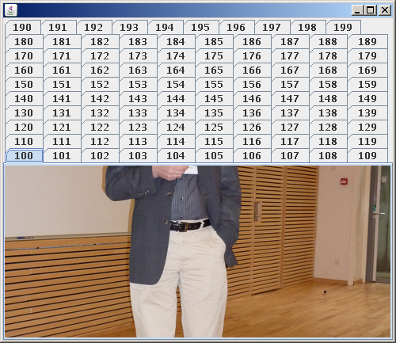
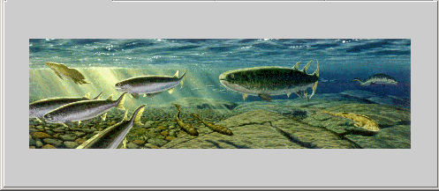

Slide 43
Example 1: Image Proxy
package proxyPattern;
public interface Image {
public void displayImage();
}
Client
«interface»
Image
ProxyImage
RealImage
delegate

Slide 44
Example 2: Lazy Loading in A Word Processor
Suppose a document contains lots of multimedia objects:
  Yet should load fast…
Create proxies to represent large images, movies, etc.:
  Only load these objects on demand as they become visible on the screen (Afterall, only a small part of the document is visible at a time)

Slide 45
Lazy Loading cont…
Rather than instantiating an expensive object right away:
  Create a proxy instead, and give the proxy to the client
The proxy creates the object on demand when the client first uses it:
  If the client never uses the object, the expense of creating it is never incurred…

Slide 46
Lazy Loading cont…
A hybrid approach can be used:
  The proxy implements some operations itself.
  Create the real object only if the client invokes one of the operations it cannot perform…
A proxy stores necessary information to create the object on-the-fly:
  file name, network address, etc.

Slide 47
Graphic
Draw()
GetExtent()
Store()
Load()
Document Editor
Image
imageImp
extent
Draw()
GetExtent()
Store()
Load()
ImageProxy
fileName
extent
Draw()
GetExtent()
Store()
Load()
if(image==0)
image=LoadImage(fileName);
Image.Draw();
if(image==0)
return(extent);
else
return(image.GetExtent();

Slide 48
Image Proxy Example 1
interface Image {
public void displayImage();
public void loadImage();
}
class RealImage implements Image {
private String filename;
public RealImage(String filename) {
this.filename = filename;
System.out.println("Loading "+filename);
}
public void displayImage() {
System.out.println("Displaying "+filename); }
}

Slide 49
Proxy Pattern Example 1
public class ProxyImage implements Image {
private String filename;
private Image image;
public ProxyImage(String filename){
this.filename = filename;
}
public void displayImage() {
if (image == null) {
image = new RealImage(filename);
//load only on demand
}
image.displayImage();
}
}
delegate request
to real subject
Notes:
Lazy evaluation

Slide 50
Proxy Example 1 - the Client
public class ProxyExample {
public static void main(String[] args) {
ArrayList<Image> images = new ArrayList<Image>();
images.add(new ProxyImage("HiRes_10MB_Photo1"));
images.add(new ProxyImage("HiRes_10MB_Photo2"));
images.add(new ProxyImage("HiRes_10MB_Photo3"));
images.get(0).displayImage();
images.get(1).displayImage();
images.get(0).loadImage();
}
}

Slide 51
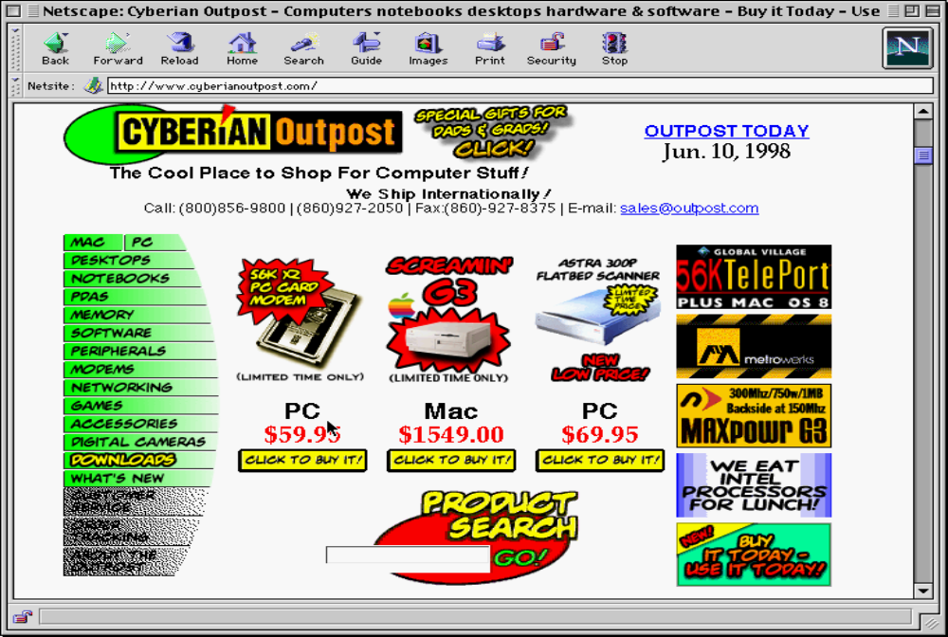
Before Proxy…

Slide 52
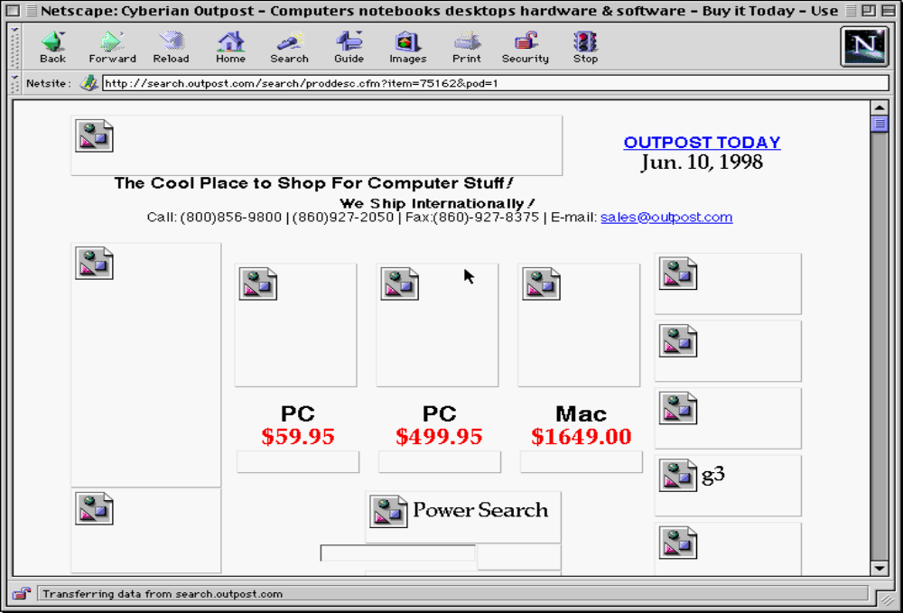
After Proxy…

Slide 53
Remote Proxy
The proxy object:
  Assembles data into a network message
  Sends it to the remote object
A remote receiver:
  Receives data,
  Turns it into a local message that is sent to the remote object

Slide 54
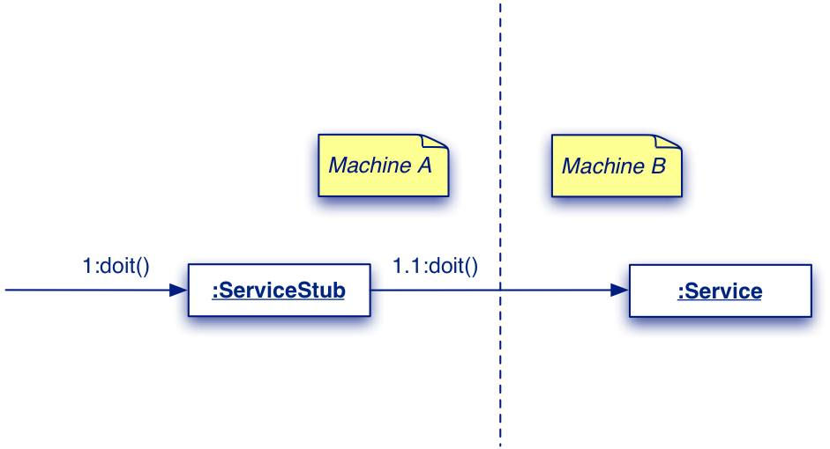
Proxy remote access example

Slide 55
Remote Proxy
Stand-in for an object often needed because it is:
  Not locally available;
  Instantiation and access are complex
  Needs protected access for security.
The stand-in must:
  Have the same interface as the real object;
  Handle as many messages as it can;
  Delegate messages to the real object when necessary.

Slide 56
Remote Proxy Pattern Structure
Supplier
<<interface>>
request()
Client
ProxySupplier
RealSupplier

Slide 57
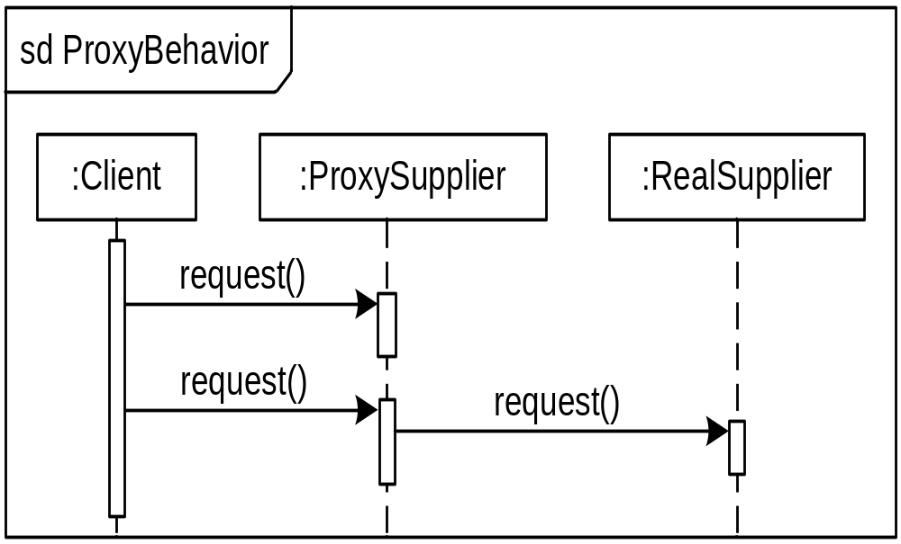
Proxy Pattern Behavior
request0()

Slide 58
Proxy: An Analysis
Consequences:
A Proxy decouples clients from servers. A Proxy introduces a level of indirection.
Proxy differs from Adapter in that it does not change the object’s interface.

Slide 59
Proxy Usage: Another Example
Enterprise JavaBeans and RMI provide examples of proxy usage:
  A client for RMI or EJBs gets a proxy version of an object (called stub)
  The proxy communicates (over the network) with the actual object
  The proxy object makes remote communication appear (almost) identical to a local connection.

Slide 60

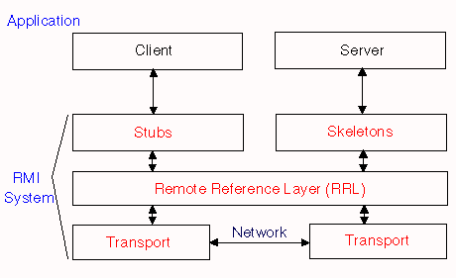
Java API Usage
java.rmi library --- “Remote Method Invocation”
Allows objects in separate virtual machines to be used as if local
Uses “stub and skeleton” to handle communication

Slide 61

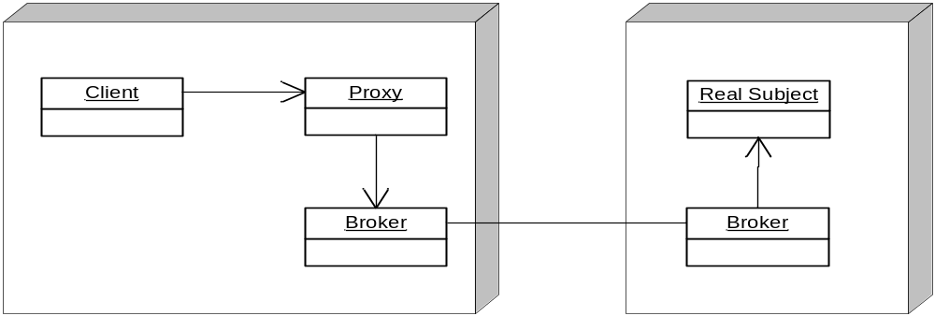
Known Uses: Broker Objects
The Client and Real Subject are in different processes or on different machines:
  So a direct method call will not work
The Proxy's job is to pass the method call across process or machine boundaries:
  Return the result to the client (with Broker's help)

Slide 62

CORBA example
Interface
Repository
client application
ORB (server)
Stub objects have full
public interface, but no data.
They just push a message
over to the server.
CORBA
IDL stubs
IDL skeletons
Object
Implementations
network
Generated
by a tool
Developers
fill in details
requests
responses

Slide 63
Uses #3 and #4: Java Collections
Read-only Collections:
  Wrap collection object in a proxy that only allows read-only operations to be invoked on the collection
  All other operations throw exceptions
  List unmodifiableList=Collections.unmodifiableList(List list);
    Returns read-only List proxy
Synchronized Collections
  Wrap collection object in a proxy that ensures only one thread at a time is allowed to access the collection
  Proxy acquires lock before calling a method, and releases lock after the method completes
  List Collections.synchronizedList(List list);
    Returns a synchronized List proxy

Slide 64
Proxy Uses #5: Secure Objects
Different clients have different levels of access privileges to an object
Clients access the object through a proxy
The proxy either allows or rejects a method call:
  Depending on what method is being called and who is calling it (i.e., the client's identity)

Slide 65
Proxy Use #6: Copy-on-Write
Multiple clients share the same object:
  as long as nobody tries to change it
When a client attempts to change the object:
  They get their own private copy of the object
Read-only clients continue to share the original object:
  while writers get their own copies
Maximize resource sharing, while making it look like everyone has own object.

Slide 66
Use #6: Copy-on-Write
Highly optimized String classes often use this approach.
To make this work:
  Clients are given proxies rather than direct references to the object.
When a write operation occurs:
  A proxy makes a private copy of the object on-the-fly to insulate other clients from the changes …

Slide 67
Proxy Known Uses: Copy-on-Write
Before any Write
Client A
Proxy A
Client B
Proxy B
Real Subject
Client C
Proxy C
After Write by C
Client A
Proxy A
Client B
Proxy B
Real Subject
Client C
Proxy C
Real Subject Copy

Slide 68
Uses #7: Reference Counting
Client A
Proxy A
Client B
Proxy B
: Real Subject
RefCount : int
Client C
Proxy C
Proxies maintain the reference count inside the object
The last proxy to go away is responsible for deleting the object:
  That is, when the reference count goes to 0, delete the object.

Slide 69
Proxy: Related Patterns
Adapter:
  Provides a different interface to an object.
Decorator:
  Similar structure as proxy, but different purpose.
  Decorator adds responsibilities whereas proxy controls access.

Slide 70
Proxy vs. Decorator
Both patterns create a “wrapper” around another object.
  But an adapter has a different interface than the wrapped object.
  While a Decorator adds additional responsibilities to an object, a Proxy “controls access” to an object.
    Not only that Proxy does not add any responsibilities, it might actually prevent access to some functionalities.
    E.g. Read-only collections, Secure objects

